Slide 1
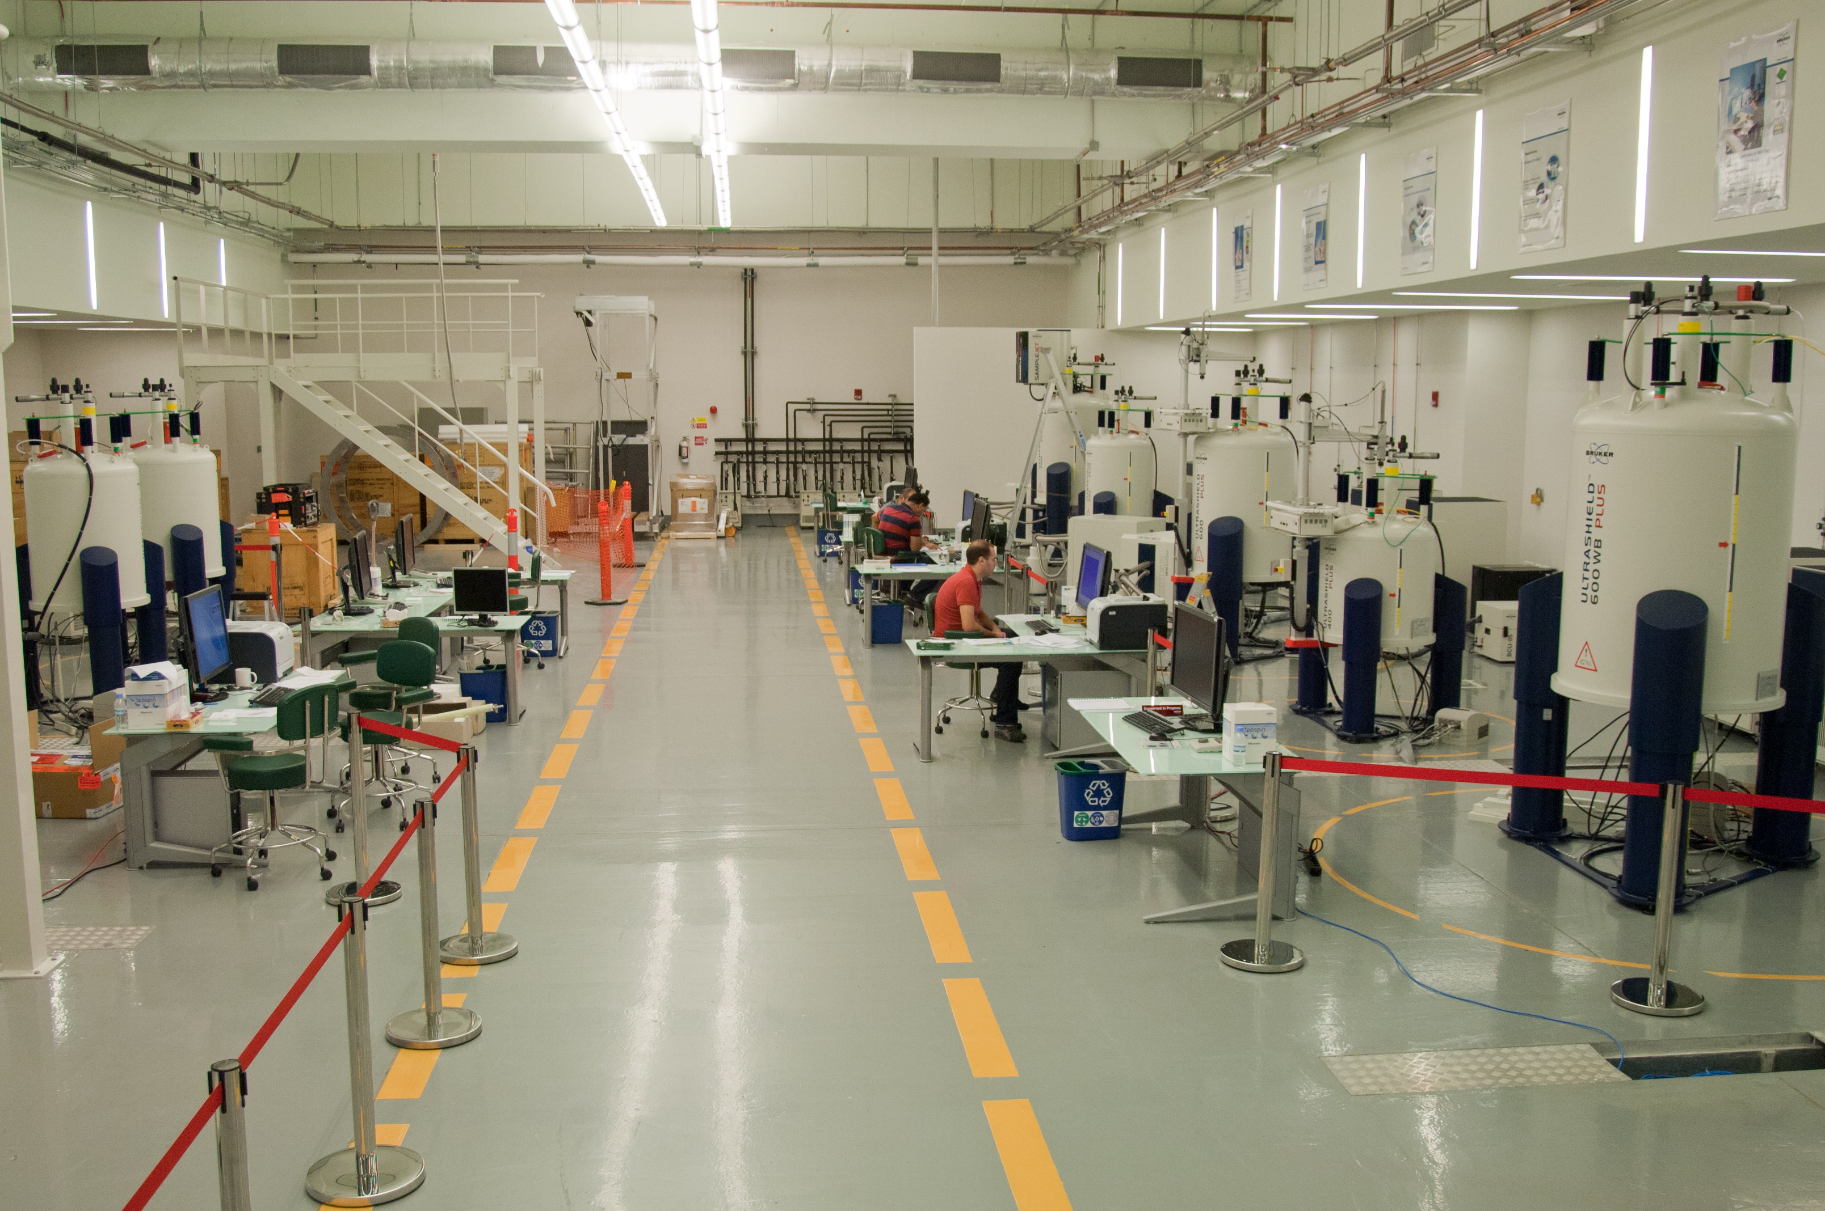
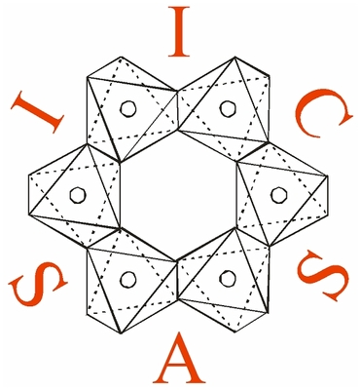
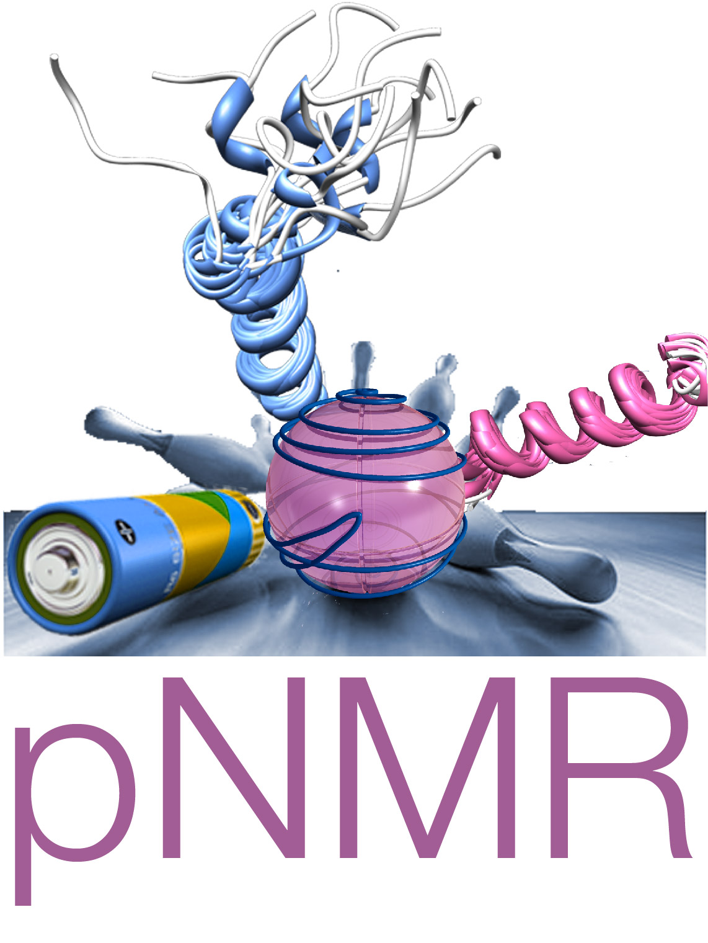
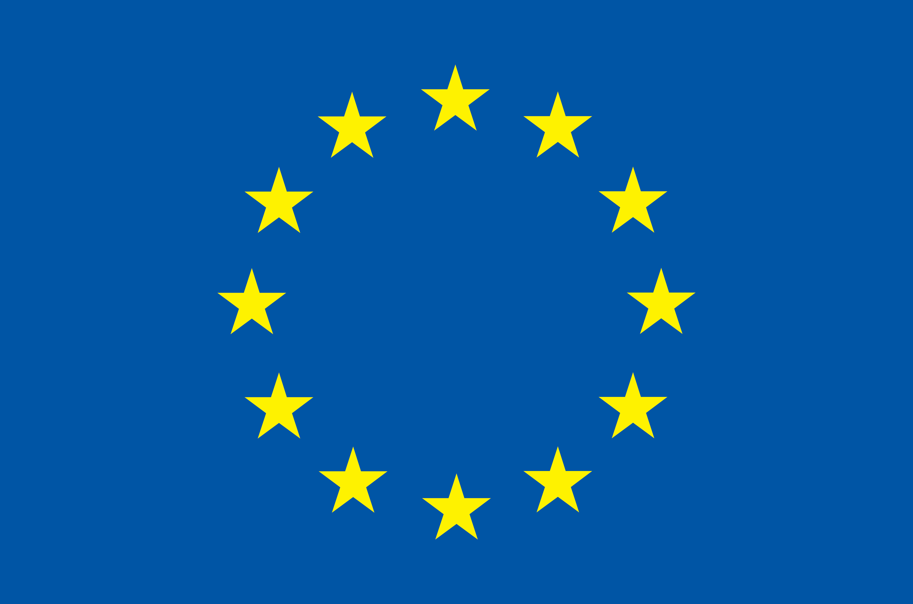
Fully Relativistic Density Functional Theory :
Developments and Applications

Slide 2
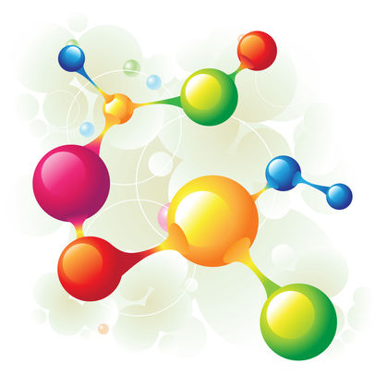
Talk Outline
Career History
Scientific Work
Nuclear magnetic resonance applied to paramagnetic compounds.
Automated code-generation for applying perturbation theory to multireference wavefunctions.
Time-dependent density functional theory in a 4-component framework.

Slide 3
Career History
2013 - 2016 : PhD studies (Univ. Komenskeho, Univ. Stockholm, Giotto Biotech, Univ. Oulu)
“Fully relativistic calculations of magnetic resonance parameters with application to paramagnetic NMR.”
2017 - 2018 : Postdoctoral Fellow (Northwestern Univ.)
Theoretical development and implementation of quasi-degenerate 4-component perturbation theory.
2019 – present : Scientist (Slovak Academy of Sciences)
Implementation of time-dependent density functional theory in a matrix-Dirac-Kohn-Sham framework.

Slide 4
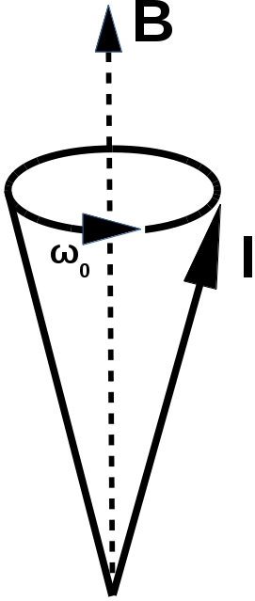
Nuclear Magnetic Resonance (NMR)
Characterize system based on its response to an external magnetic field.
Nuclear spins will precess about the magnetic field.
This is the Larmor precession, it is what experiments measure.
The frequency of the Larmor precession influenced by
1) Nuclear isotope.
2) Electron-nuclear interactions.
3) Nuclear-nuclear interactions.
4) And many others....
Fig. 1: Larmor precession cone.
Fig 2: Nucleon.

Slide 5
Paramagnetic NMR
Applying NMR techniques to systems with unpaired electron magnetic moments.
Siginificantly more technically challenging:
Interaction of the electron magnetic moments obfuscates the nuclear interactions.
Recent experimental advances have made such measurements more accurate, and practically useful [cite?]
Until recently, theoretical development of pNMR has been comparatively neglected due to lack of practical relevance.

Slide 6
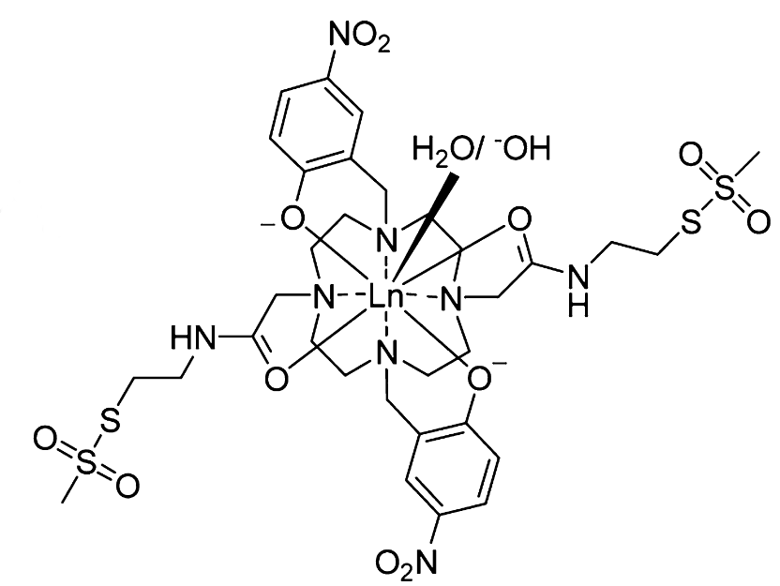
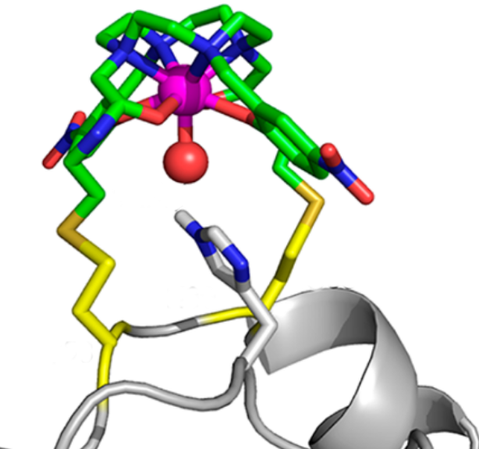
Structure Determination with pNMR
Use paramagnetic tags to make molecules artifically paramagnetic.
Compare spectra for tagged and untagged molecules.
(a)
W.-M. Liu, P. H. Keizers, M. A. Hass, A. Blok, M. Timmer, A. J. Sarris, M. Overhand, and M. Ubbink, JACS, 41 (2012).
(b)
Fig.4 (a) Lewis structure of CLaNP-7 parmagnetic tag (b) CLaNP-7 binding to protein.

Slide 7
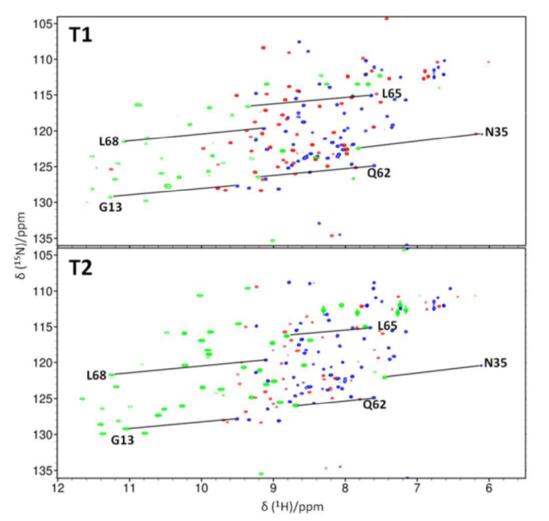
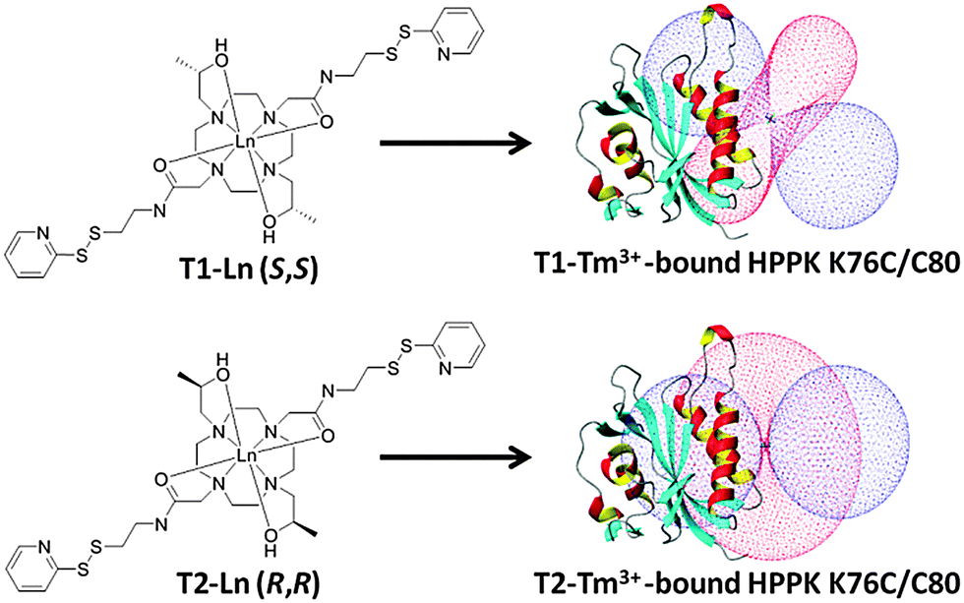
Paramagnetic shifts in NMR spectra
M. Lee, M. Dennis, J. Swarbrick, and B. Graham, Chem. Comm., 52, (2016).
(a)
(a)
(b)
(b)
Fig. 5 (a) & (b) 2D spectra corresponding to tags in Fig. 6 (a) & (b).
Fig. 6 (a) & (b) Protein with para-magnetic tag bound in two different positions.

Slide 8
Paramagnetic shifts in NMR spectra
M. Lee, M. Dennis, J. Swarbrick, and B. Graham, Chem. Comm., 52, (2016).
Two main effects:
Pseudocontact shift (PCS): Coupling of nucleus with electron spin-density.
Residual Dipolar Coupling (RDC): more complicated.
(a)
(b)
Fig. 5 (a) & (b) Protein with para-magnetic tag bound in two different positions.

Slide 9
Paramagnetic shifts in NMR spectra
M. Lee, M. Dennis, J. Swarbrick, and B. Graham, Chem. Comm., 52, (2016).
Two main effects:
Pseudocontact shift (PCS): Coupling of nucleus with electron spin-density.
Residual Dipolar Coupling (RDC): more complicated.
New effect:
Paramagnetic J-coupling enhancement.
(a)
(b)
Fig. 5 (a) & (b) Protein with para-magnetic tag bound in two different positions.

Slide 10
Pseudocontact shift
Interaction of nuclear moment with electron spin density.
Unique to paramagnetic systems; it is only possible when there are unpaired electrons.

Slide 11
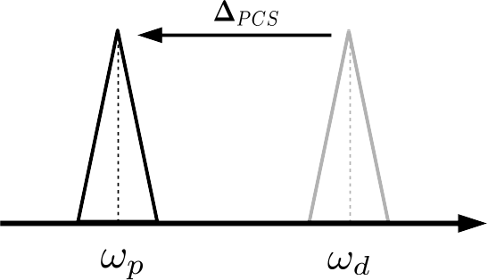
Pseudocontact shift
Pseudocontact shift moves peaks in the NMR spectra

Slide 12
Residual dipolar coupling
The spins of different nuclei can interact via dipolar coupling:
Interaction given by:

Slide 13
Residual dipolar coupling
The spins of different nuclei can interact via dipolar coupling:
Averaging over all directions causes this term to vanish.
Due to anisotropy caused by paramagnetic tag this term does not vanish.

Slide 14
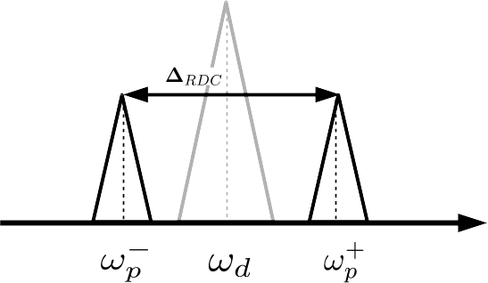
Residual dipolar coupling
Residual dipolar coupling splits peaks in the pNMR spectra

Slide 15
Residual dipolar coupling
Residual dipolar coupling splits peaks in the pNMR spectra
Could there be increased splitting due to a paramagnetic enhancement of J-coupling?

Slide 16
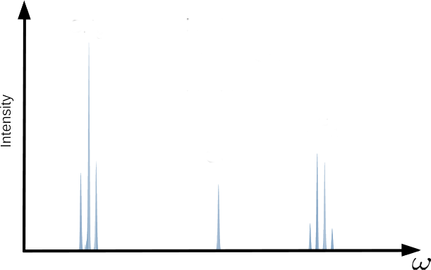
Ethanol NMR spectrum
CH₃
H
H
H
C
C
O
H
H
H
Fig. 3 : 90 MHz Proton NMR spectra for ethanol in CDCl₃. Data retrieved from the AIST spectral database for organic compounds [2].
CH₂
OH
[2] http://sdbs.db.aist.go.jp/sdbs/cgi-bin/direct_frame_disp.cgi?sdbsno=13

Slide 17
J-coupling
Interaction is mediated by electron charge density:
Nuclear spin-spin interaction is mediated by the currents which the nuclear moments induce in the electron density.
e⁻
e⁻
e⁻
e⁻
e⁻
e⁻
e⁻
e⁻
e⁻
e⁻
e⁻
e⁻
e⁻
e⁻

Slide 18
J-coupling
CH₃
H
H
Fig. 3 : 90 MHz Proton NMR spectra for ethyl alcohol in CDCl₃ .Data retrieved from spectral database for organic compounds[2].
H
C
C
O
H
H
H
CH₂
OH
[2] http://sdbs.db.aist.go.jp/sdbs/cgi-bin/direct_frame_disp.cgi?sdbsno=13

Slide 19
Paramagnetic J-coupling enhancement
Interaction is mediated by electron spin density:
Paramagnetic systems have unparied electrons and the nuclear spins can interact via the electron spins.

Slide 20
Paramagnetic J-coupling enhancement
New contribution to spectra: Paramagnetic enhancement of J-coupling.
J. Autschbach, J. Annu. Rep. Comput. Chem. (2015).
P. J. Cherry, S. A. Rouf, and J. Vaara, JCTC, 13 (3), 1275-1283 (2017)

Slide 21
Hyperfine terms
New contribution to spectra: Paramagnetic enhancement of J-coupling.
The hyperfine interaction couples nuclear spins to the electron spin density.
J. Autschbach, J. Annu. Rep. Comput. Chem. (2015).
P. J. Cherry, S. A. Rouf, and J. Vaara, JCTC, 13 (3), 1275-1283 (2017)

Slide 22
SS dyadic
New contribution to spectra: Paramagnetic enhancement of J-coupling.
The hyperfine interaction couples nuclear spins to the electron spin density.
Spin density then “transmits” interaction of nuclear spins.
J. Autschbach, J. Annu. Rep. Comput. Chem. (2015).
P. J. Cherry, S. A. Rouf, and J. Vaara, JCTC, 13 (3), 1275-1283 (2017)

Slide 23
Paramagnetic J-coupling enhancement
New contribution to spectra: Paramagnetic enhancement of J-coupling.
The hyperfine interaction couples nuclear spins to the electron spin density.
Spin density then “transmits” interaction of nuclear spins.
No dependence on distance between nuclei!
J. Autschbach, J. Annu. Rep. Comput. Chem. (2015).
P. J. Cherry, S. A. Rouf, and J. Vaara, JCTC, 13 (3), 1275-1283 (2017)

Slide 24
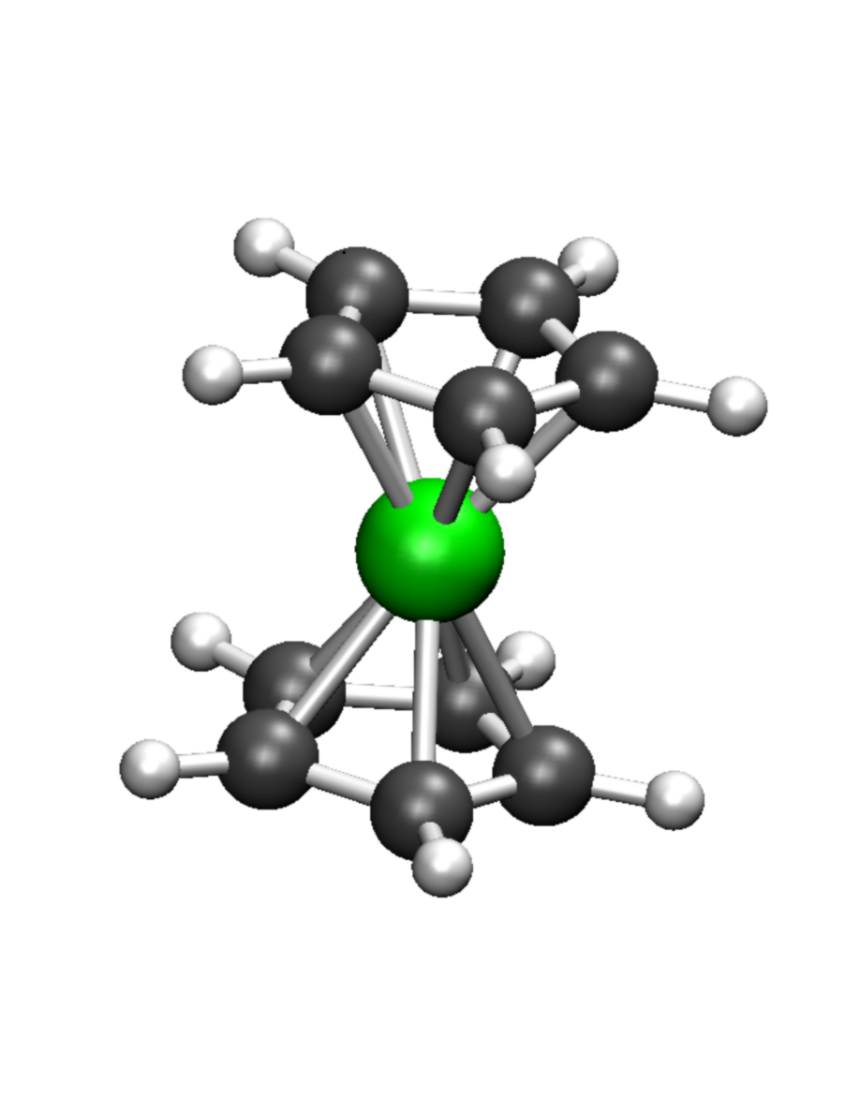
Test Systems: Metallocenes

Slide 25
Test Systems: Metallocenes
Fe
Ferrocene:
Diamagnetic.
No unpaired electrons.
No J enhancement.

Slide 26
Test Systems: Metallocenes
Fe
Cr
Ni
Ferrocene:
Diamagnetic.
No unpaired electrons.
No J enhancement.
Chromocene:
Paramagnetic.
Three unpaired electrons.
J enhancement.
Nickelocene:
Paramagnetic.
Three unpaired electrons.
J enhancement.

Slide 27
J-coupling Notation
Number of bonds seperating nuclei
³J_{HH}
Coupled nuclei

Slide 28
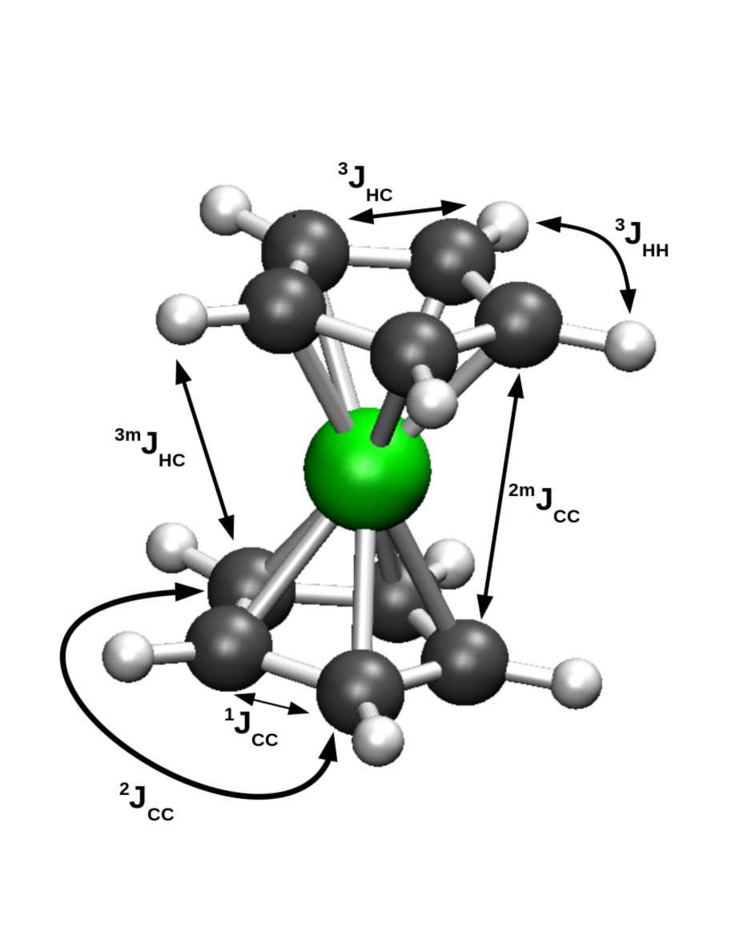
J-enhancement in metallocenes
 | J(Hz) | Enhancement (Hz)
 | FeCp₂ | NiCp₂ | CrCp₂
 | (m=1) | (m=4) | (m=4)
³J_{HH}
¹J_{CC}
¹J_{CH}
^{4m}J_{HH}
^{2m}J_{CC}
^{3m}J_{CH}
Table 1: Comparison between unenhanced isotropic J-values for ferrocene, and the corresponding enhancement in nickelocene and chromocene.
Fig. 8: Metallocene structure. Hydrogens
→ white. Carbons → grey. Metal → green.

Slide 29
J-enhancement in metallocenes
 | J(Hz) | Enhancement (Hz)
 | FeCp₂ | NiCp₂ | CrCp₂
 | (m=1) | (m=4) | (m=4)
³J_{HH} | 8.0 | 0.65 | 1.50
¹J_{CC} | 88.5 | 5.42 | -0.02
¹J_{CH} | 172.9 | -1.17 | -0.04
^{4m}J_{HH}
^{2m}J_{CC}
^{3m}J_{CH}
Same
Ring
Table 1: Comparison between unenhanced isotropic J-values for ferrocene, and the corresponding enhancement in nickelocene and chromocene.
Fig. 8: Metallocene structure. Hydrogens
→ white. Carbons → grey. Metal → green.

Slide 30
J-enhancement in metallocenes
 | J(Hz) | Enhancement (Hz)
 | FeCp₂ | NiCp₂ | CrCp₂
 | (m=1) | (m=4) | (m=4)
³J_{HH} | 8.0 | 0.65 | 1.50
¹J_{CC} | 88.5 | 5.42 | -0.02
¹J_{CH} | 172.9 | -1.17 | -0.04
^{4m}J_{HH} | 0.0 | 1.24 | 1.79
^{2m}J_{CC} | -0.3 | 5.66 | 0.11
^{3m}J_{CH} | 0.0 | -1.66 | -0.48
Different
Ring
Table 1: Comparison between unenhanced isotropic J-values for ferrocene, and the corresponding enhancement in nickelocene and chromocene.
Fig. 8: Metallocene structure. Hydrogens
→ white. Carbons → grey. Metal → green.

Slide 31
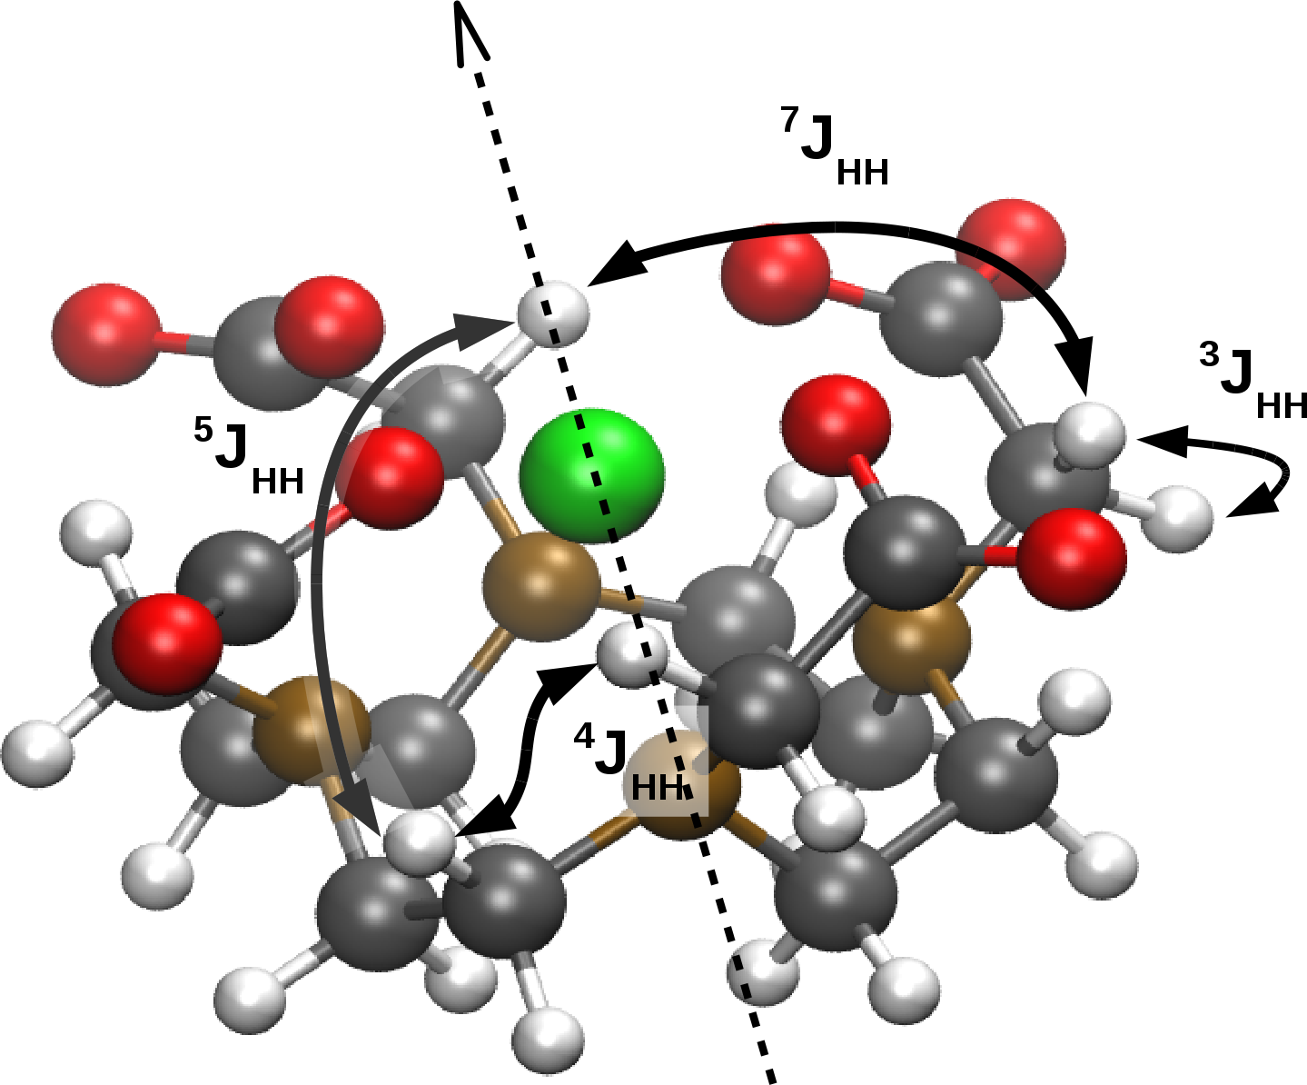
J-enhancement in Gd-DOTA
 | ∆J^{iso}(Hz) | ∆J^{aniso}(Hz)
³J_{HH} | 2.40 | -1.35
⁴J_{HH} | 2.58 | -1.99
⁵J_{HH} | 6.59 | -5.4
⁷J_{HH} | -3.27 | 9.41
Table 2: Enhancement to isotropic and anisotropic J-values for Gd-DOTA.
Fig. 9: Gd-DOTA structure. Oxygen → red. Nitrogen → brown. Other elements as before.

Slide 32
Paramagnetic spin-spin coupling enhancement
Q1) Is J-coupling qualitatively different in systems with unpaired electrons?
Q2) Do we need to account for it when analyzing pNMR spectra?

Slide 33
Paramagnetic spin-spin coupling enhancement
Q1) Is J-coupling qualitatively different in systems with unpaired electrons?
Q2) Do we need to account for it when analyzing pNMR spectra?
A1) Yes, nuclear spins are coupled by the electron spin-density, without explicit dependence on distance.
A2) Probably not at short distances, could be significant at long distances.

